Slide 1
TRAUMA PROGRAM
THE PEARL WELLNESS FOR WOMEN

Slide 2
OVERVIEW
At The Pearl, trauma work is integrated into a structured continuum of care that prioritizes stabilization, safety, and progressive emotional processing. The goal is to support clients in addressing the underlying traumatic experiences that often contribute to addiction, while ensuring they remain regulated, empowered, and connected to a supportive 12 step recovery community. Healing in community is a vital part of trauma recovery, as safe, attuned relationships help rebuild trust, reduce isolation, and reinforce new, healthier patterns of connection fostered by the 12 steps.

Slide 3
PHASE 1: SAFETY & STABILIZATION (WEEKS 1–4)
Goal: Establish physical, emotional, and psychological safety.
Purpose: Jumping into trauma processing without first establishing safety and stabilization can overwhelm the nervous system, leading to emotional dysregulation, a renewed sense of helplessness, and a heightened risk of reverting to maladaptive coping mechanisms such as substance use and leaving treatment.
Objectives:
Psychoeducation on Trauma & Nervous System
Routine, Predictability, and Grounding
Therapeutic Alliance Building
Avoidance of Deep Processing Too Soon
Clients learn about the impact of trauma on the brain, body, and behaviors.
Daily schedules, movement (yoga, barre, Pilates), and mindfulness p build internal safety.
Clinicians prioritize trust and rapport, setting the foundation for deeper trauma work.
We focus on emotional and physical regulation and process trauma at a safe pace.

Slide 4
PHASE ONE STEP WORK:
Step 1: We admitted we were powerless over our addiction—that our lives had become unmanageable.
Acknowledging the chaos and impact of addiction with honesty and compassion
Recognizing that powerlessness isn’t the same as helplessness—it’s the first step toward change
Validating the deep sense of overwhelm that often accompanies trauma and substance use
Beginning to reclaim agency by facing reality nonjudgmentally and taking empowered steps toward healing

Slide 5
PHASE ONE STEP WORK:
Step 2: Came to believe that a Power greater than ourselves could restore us to sanity.
Trauma and substance use often disconnect us from ourselves, others, and any sense of greater meaning or purpose
Invites us to explore the possibility of reconnection and healing through something greater than our individual pain
Begin defining a Higher Power that feels safe, supportive, and personally meaningful—this could be nature, spirit, God, universal love, the recovery community
Emphasizes that belief doesn’t have to be immediate or perfect—openness and curiosity are enough
Encourages the rebuilding of trust after experiences of betrayal, abandonment, etc.
Supports that healing is relational & spiritual

Slide 6
PHASE ONE STEP WORK:
Step 3: Made a decision to turn our will & our lives over to the care of God as we understood Him.
Trauma often creates a deep need to control our environment, emotions, and
relationships as a way to feel safe
It promotes healing through connection—with community, spirit, nature, or purpose—rather than hyper-independence
While this need for control is a normal trauma response, it often leads to more distress, isolation, and rigidity
The decision to surrender control can lead to greater freedom, clarity, and emotional balance
This step is about shifting from survival mode to surrender, guided by safety, trust, and choice

Slide 7
PHASE 2: EXPLORATION & PROCESSING (WEEKS 5–8)
Goal: Begin to explore and process trauma in a titrated and contained way.
Purpose: Once both internal and environmental safety are established, clients can begin engaging with their trauma in a controlled, supportive environment. This phase allows for the gradual release and integration of traumatic material through individualized and body-based approaches, helping clients build insight, resilience, and emotional capacity without becoming overwhelmed.
Objectives:
Trauma-Informed Individual Therapy
Trauma-Focused Group Therapy
Creative & Experiential Modalities
Body-Based Healing
Modalities like acupuncture, massage, breathwork, physical activity, and
mindfulness, help release stored trauma from the body.
(This depends on what modalities our specific clinicians use)
Topics include triggers, the inner critic, safe/calm place (EMDR prep), inner child work, and relational healing.
Use of art therapy, music therapy, psychodrama and movement to safely access and process emotion.

Slide 8
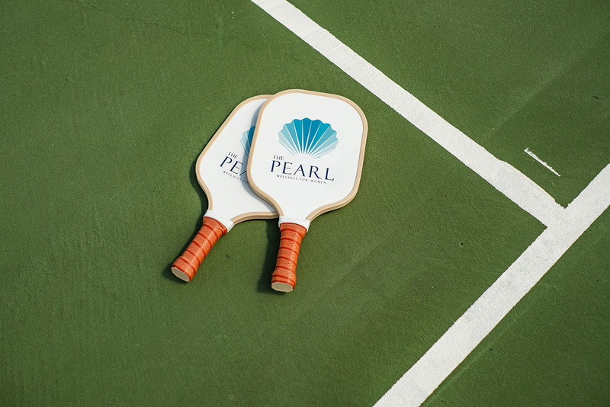
PHASE 3: INTEGRATION & EMPOWERMENT (WEEKS 9–12)
Goal: Strengthen new narratives, build coping skills, & prepare for long-term.
Purpose: In this final phase, clients begin integrating the insights, skills & healing gained throughout treatment into a cohesive sense of self. By strengthening healthy coping strategies, reinforcing relational & spiritual supports & cultivating meaning beyond trauma & addiction, clients build the confidence & internal resources needed for sustained recovery & long-term emotional resilience.
Objectives:
Meaning-Making & Post-Traumatic Growth
Relapse Prevention with a Trauma Lens
Relational Repair & Boundary Work
Community Support & Spiritual Practices
Clients explore identity beyond trauma and addiction.
Understand trauma-related relapse triggers and practice emotional regulation techniques.
Family therapy, role plays, and education on healthy boundaries and
communication.
Completion of the 12-steps, aftercare plan prioritizing community, sobriety, and
service work to help others in recovery.

Slide 9
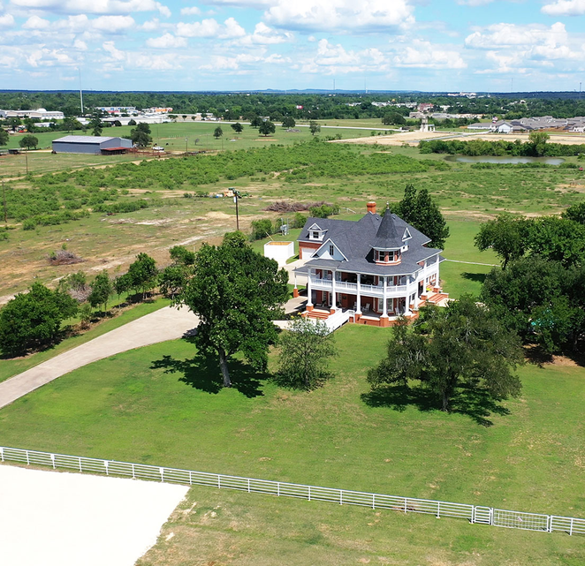
CONTACT US
Website
www.thepearlrecoverycenter.com
Phone
+1-850-749-5078
Address
125 Upper Elgin River Road
Elgin, TX 78621

